Slide 1

ONLINE COLLABORATION SYSTEM

Slide 2

INTRODUCTION
Teamwork is the collaborative effort of a group to achieve a common goal or to complete a task in the most effective and efficient way.
This concept is seen within the greater framework of a Team , which is a group of interdependent individuals who work together towards a common goal.

Slide 3







PROBLEM STATEMENT
Lack of central location for depositing files and messages.
Fig – Demonstrating different modes of communication and file sharing

Slide 4

Unavailability of team members at particular location.
Fig – Team members around the globe.

Slide 5



Total process (team working) takes a lot
of time.
Since all the information’s are scattered so the files may get lost and result in lose of important information.

Slide 6
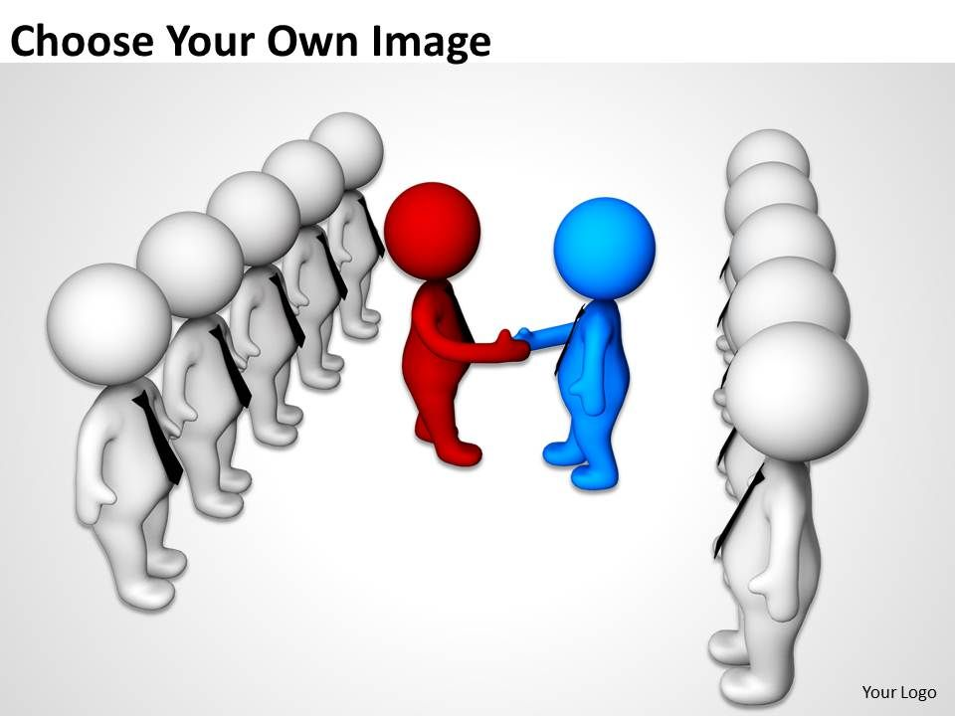
SOLUTION
The Solution to these problems is the existence of a Electronic Platform which helps the users to lay out team management in a very effective & efficient manner , & which is easily available to them.
Thus, Our Proposed System , known as Online Team Collaboration System , is the Solution to these Problems.

Slide 7



The Online Collaboration System is nothing but the electronic counter part of Team Work. It will not replace the traditional channels of communication, such as phone or fax, but will act as just another extension for the group of persons to work in a single project / task interacting with each other.

Slide 8

OBJECTIVE
It should be simple. Simple to set up, simple to learn and simple to use.
Making it easy to find people and information. You can organize information by people, topics, etc.
Collaboration isn't always about big teams. It's just as important to small teams and individuals. It stops you from doing the same thing twice.
Online Collaboration System simple and powerful. It should make online collaboration faster and easier. It should able to use effectively by computer novices and experts.
Information should be secure.

Slide 9

FEATURES
Team Management
Real Time
Communication
File Sharing
Security
Task Management

Slide 10
HARDWARE & SOFTWARE SPECIFICATIONS
Software Requirements –
Server
Backend Framework : Node JS 0.10 or higher installed.
Database : Mongo DB 3.2 or higher.
Operating Systems : Linux ( Kernel v3.10 or higher ),
MacOS 10.7 or higher,
Windows 7 (or Later) and Windows Server 2008 or later.
Web App Client
Browser : Chrome v51 or above ,
Firefox 54 or above ,
Edge 14 or above ,
Safari 10 or above.

Slide 11
HARDWARE & SOFTWARE SPECIFICATIONS
Hardware Requirements –
Server
HDD : 1.5 GB or more
RAM : 1.5 GB or more
Processor : 1 GHz or more powerful processor
Web App Client
Processor : Intel Pentium 4 processor or later that's SSE2 capable
RAM ( for Browser ) : 128 MB
HDD ( for Browser ) : 100 MB

Slide 12

MODULES
Authentication (Login & Sign Up).
Admin Dashboard.
User Dashboard.
Chatting.
File Sharing.
Team Management.
Data Store.
Project Report.

Slide 13





TECHNOLOGY USED

Slide 14
E-R DIAGRAM
Object ID
User Id
Password
Object ID
Team Id
Message ID
Sender Id
Time
Sender Id
Date
E-mail Id
File Size
User
Message
Object ID
Image File
Sends
Project Id
N
1
N
1
N
Contains
Belongs to
Works on
File
Member Id
1
N
N
Team Id
Team
Project
Project ID
Object ID
Team Id
Object ID
Start Date
End Date

Slide 15
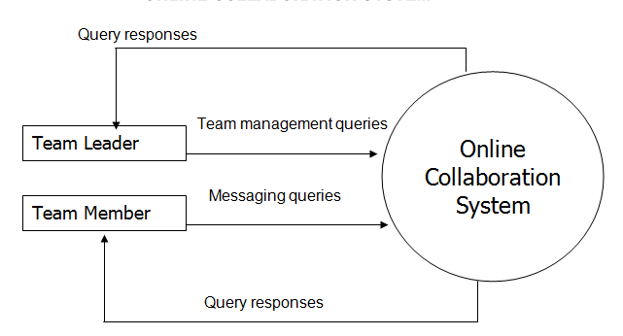
DATA FLOW DIAGRAM
Level 0 DFD

Slide 16
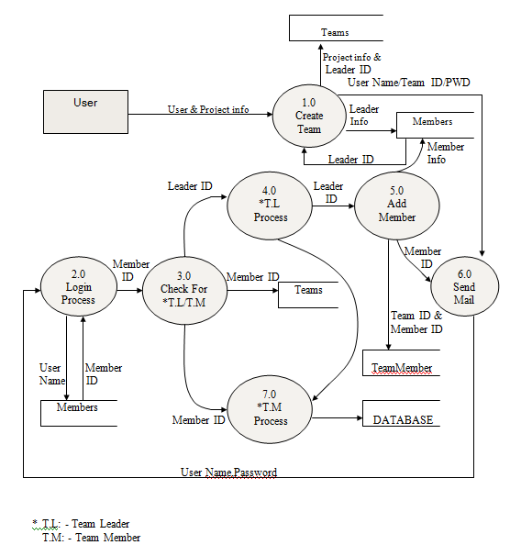
DATA FLOW DIAGRAM
Level 1 DFD

Slide 17
GANTT CHART
Task | 01Jan-05Feb | 06Feb-06Mar | 7Mar-5Apr | 6Apr-9May | 10May-10Jun | 11June-30June
Develop Project proposal | 20 days
Analysis |  | 28days
Designing |  |  | 30 days
Coding |  |  |  | 53days
Testing |  |  |  |  | 32 days
Documentation |  |  |  |  |  | 20days

Slide 18
COST ANALYSIS
Since this is an Organic project, we’ll take the respective values for the coefficients.
Lines of Code ( LOC ) = 4000
Thus, KLOC = 4000 /1000 = 4
1. Effort Applied = ab (KLOC ^ bb) [ man-months ] = 10.289 man-months.
2. Development Time = cb (Effort Applied ^ db) [ months ] = 6.0623 months.
3. People Required = Effort Applied / Development Time [ people ] = 1 people ( approx. )
ab | bb | cb | db
2.4 | 1.05 | 2.5 | 0.38

Slide 19

FUTURE SCOPE
With the changing face of technology and increasingly complex projects , it can add some features like :
Control Loops - Complex projects can be split into smaller workgroups. Thus, you can have a consolidated view of the whole project, but team members have workspaces where they can collaborate based on their functions, departments or role in the project.
Blogging - Users can post blogs for others users on the website and even provide data that can be used by other users.
Video Conferencing – Team Members can Converse with each other through Video Conferencing.
Enhanced Security – System can be made more safer by using security techniques as Two-step verification for users , etc.

Slide 20


CONCLUSION
As our world becomes increasingly connected, effective collaboration isn’t just a project management best practice but a competitive edge.
By adopting an effective collaborative project management approach, your organization will be better placed to deliver successful projects on- time and on-budget.
Complex projects with large teams in different locations are not going anywhere soon. Luckily for you, the right tool to tackle them head on is at your fingertips.
Online Team Collaboration will be the solution with unlimited projects, tasks and subtasks. It will come with time tracking, task automation workflows, Gantt chart, document management and task collaboration tools, such as video conferencing, etc.

Slide 21
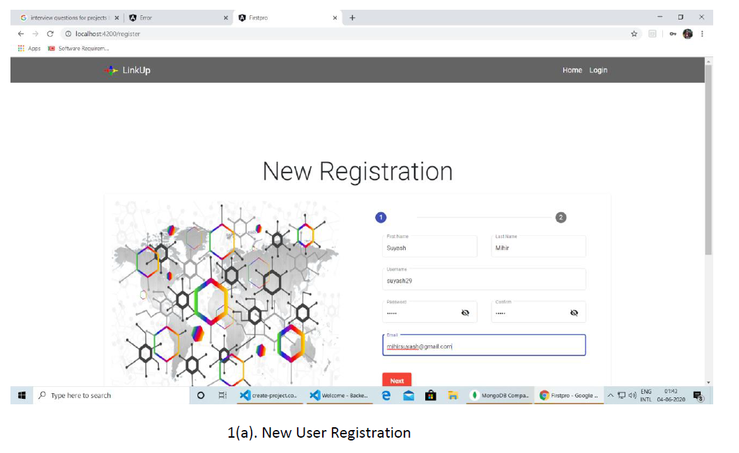
SCREENSHOTS

Slide 22
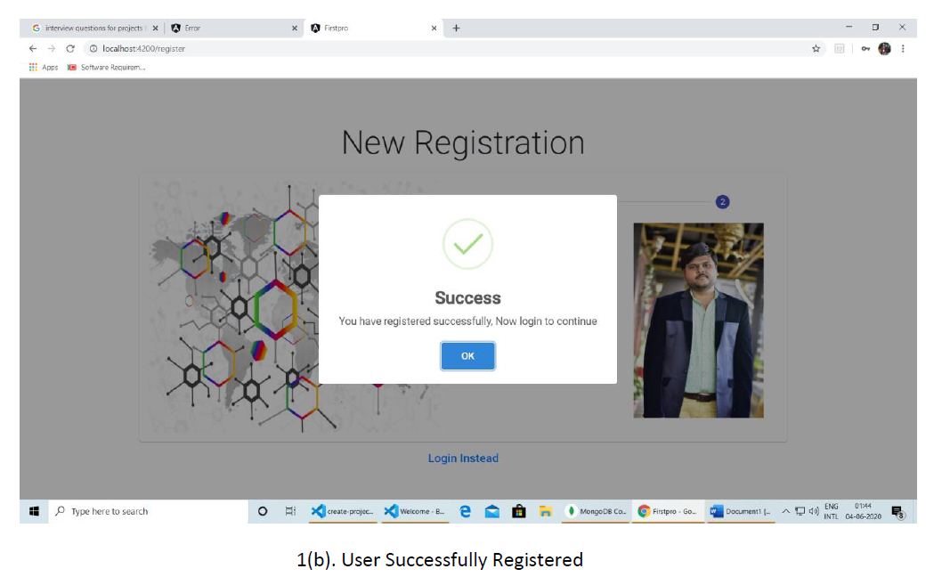
SCREENSHOTS

Slide 23
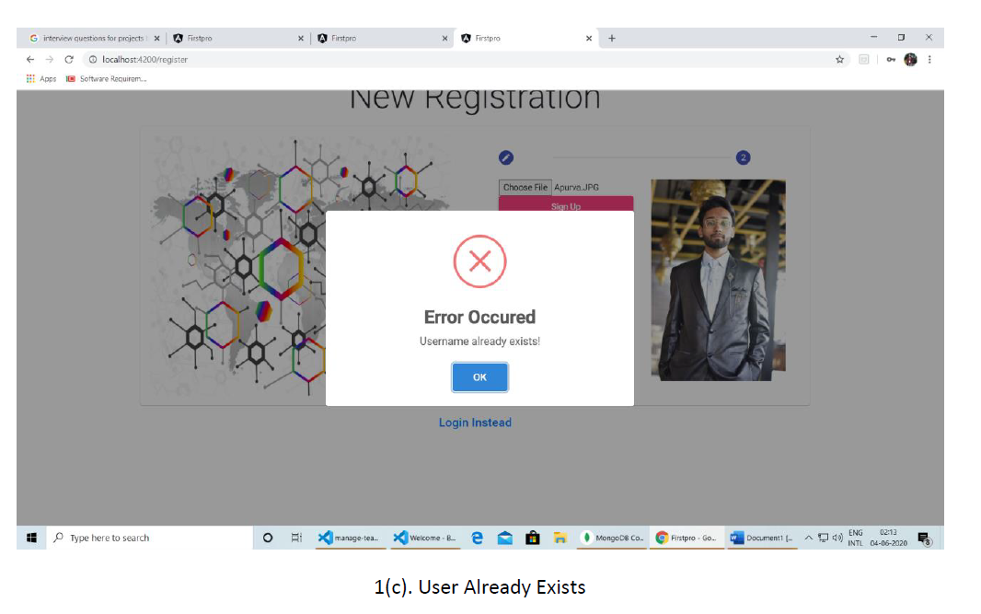
SCREENSHOTS

Slide 24
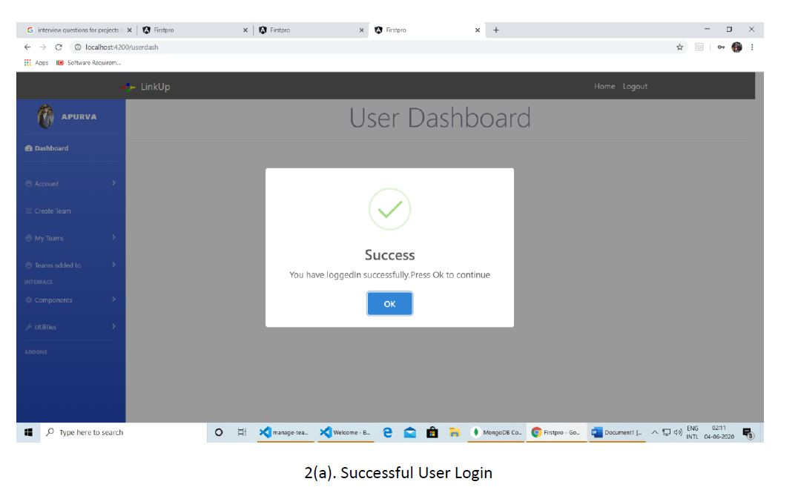
SCREENSHOTS

Slide 25
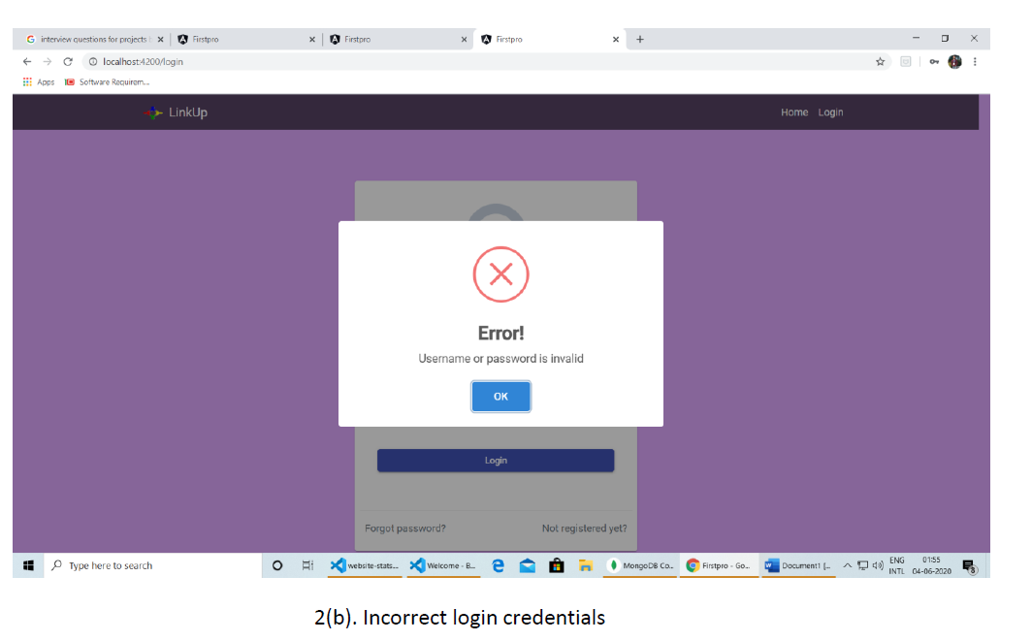
SCREENSHOTS

Slide 26
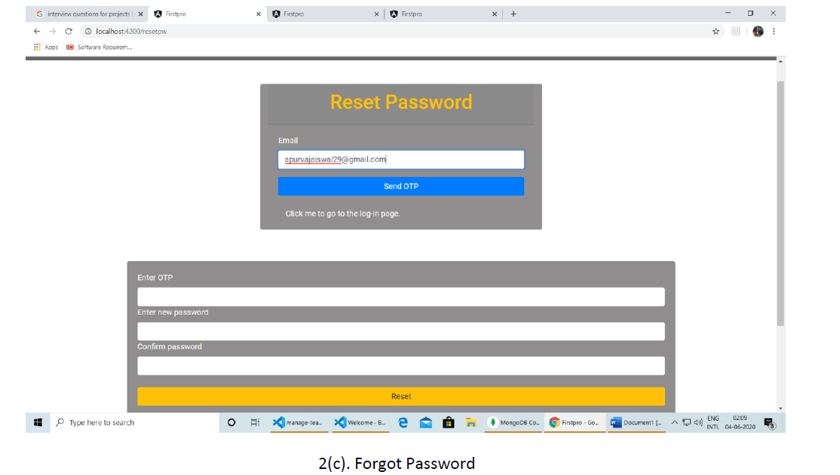
SCREENSHOTS

Slide 27
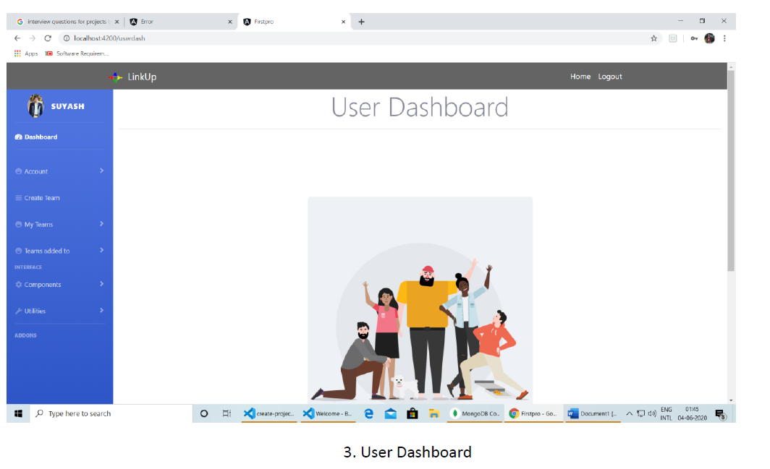
SCREENSHOTS

Slide 28
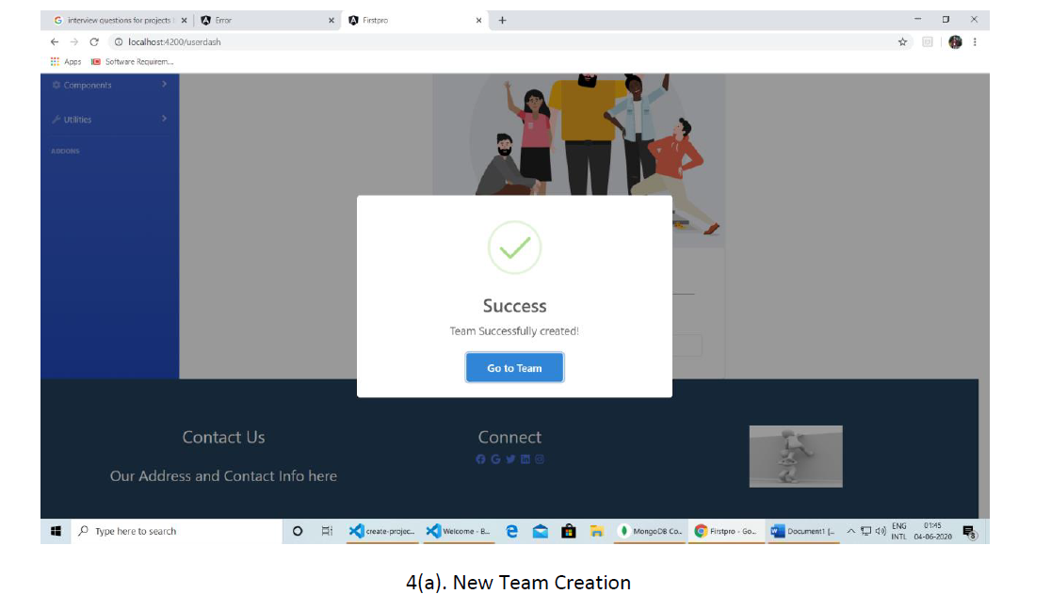
SCREENSHOTS

Slide 29
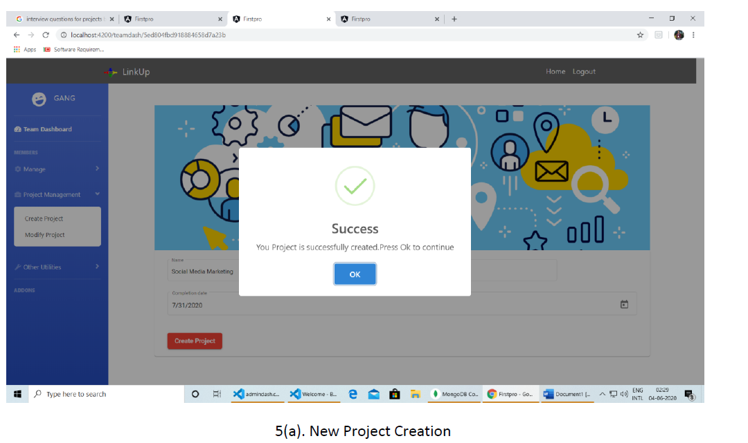
SCREENSHOTS

Slide 30
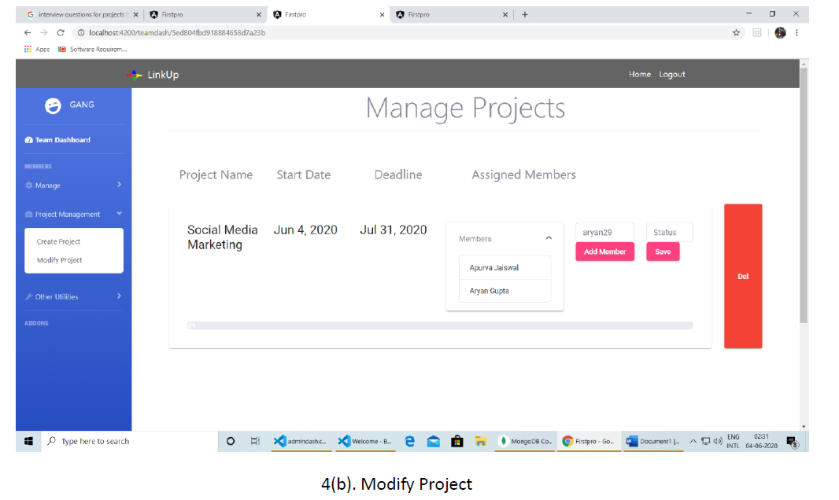
SCREENSHOTS

Slide 31
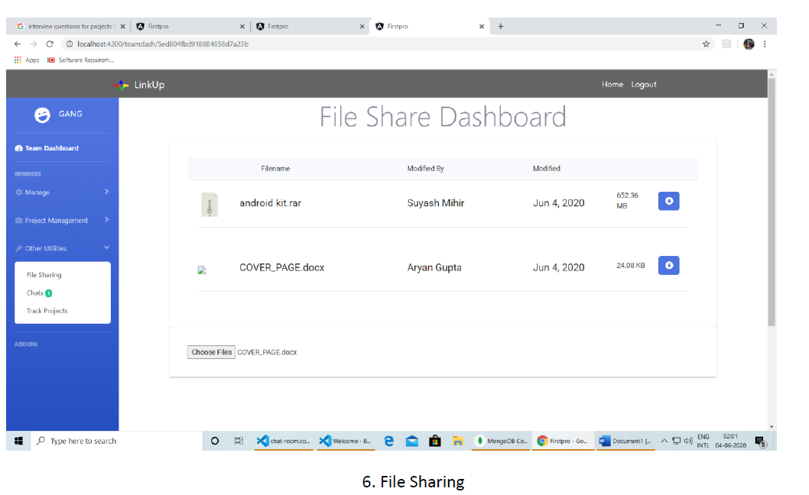
SCREENSHOTS

Slide 32
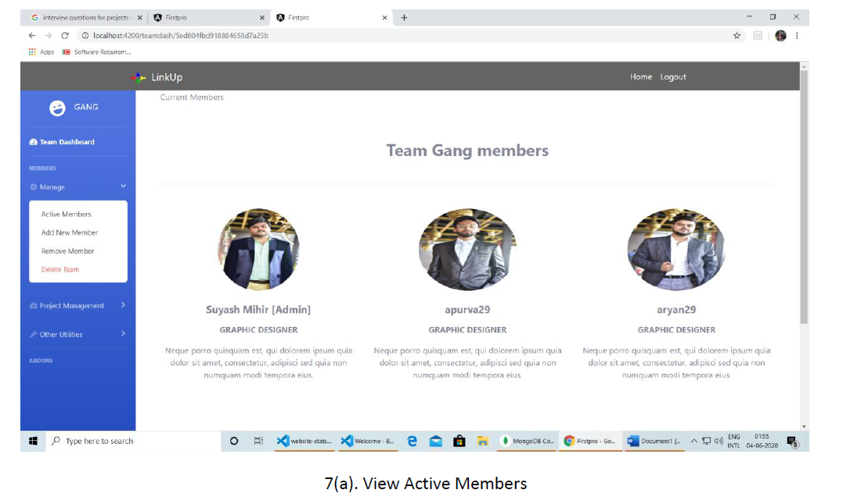
SCREENSHOTS

Slide 33
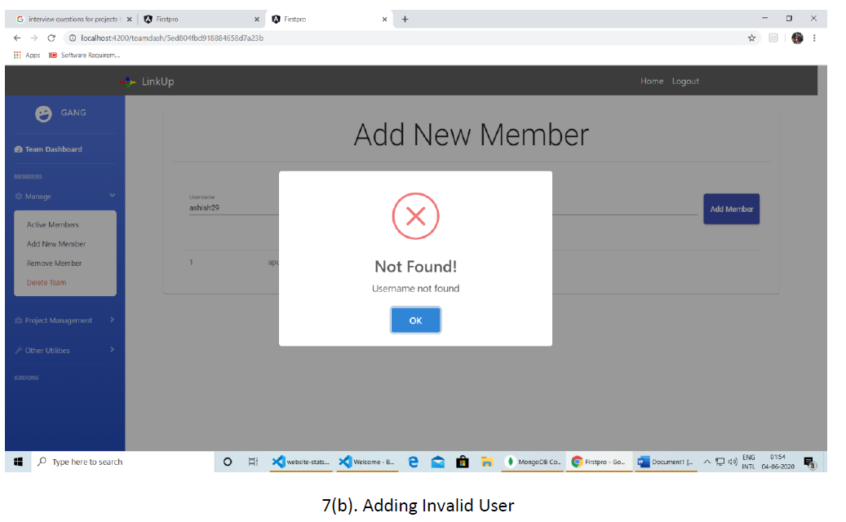
SCREENSHOTS

Slide 34
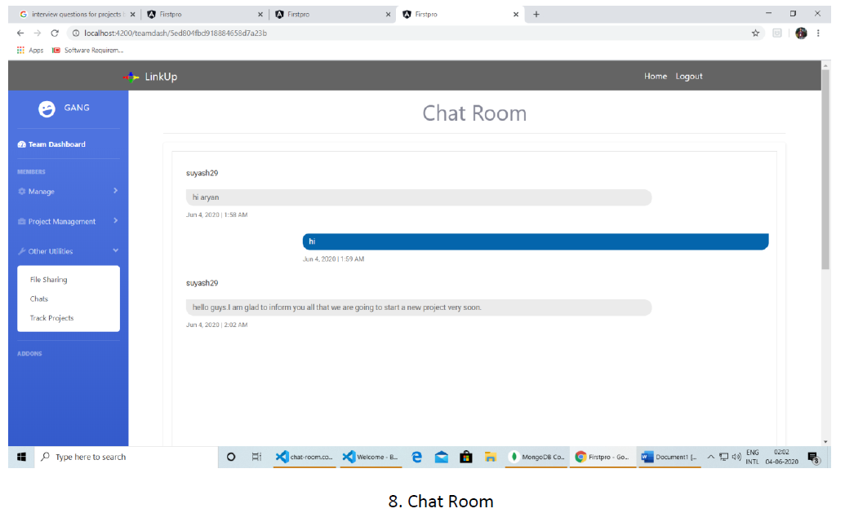
SCREENSHOTS

Slide 35
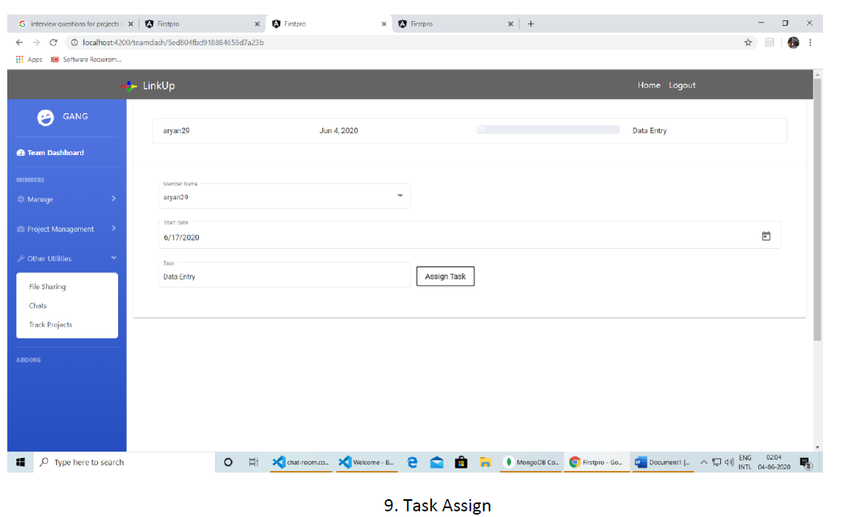
SCREENSHOTS

Slide 36
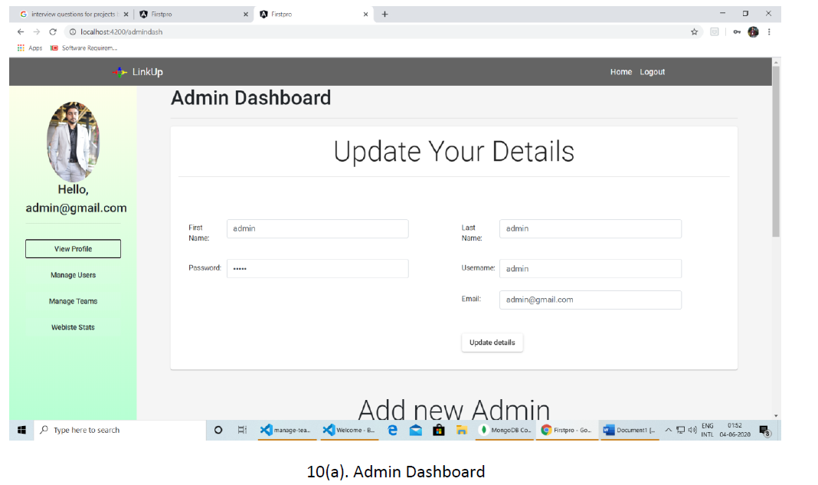
SCREENSHOTS

Slide 37
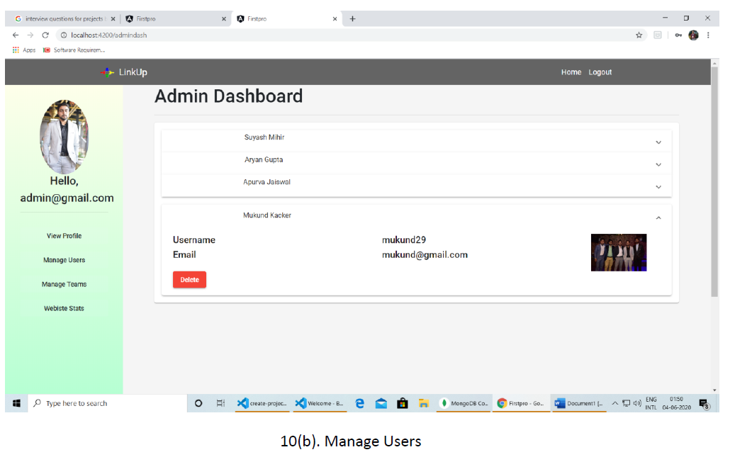
SCREENSHOTS

Slide 38
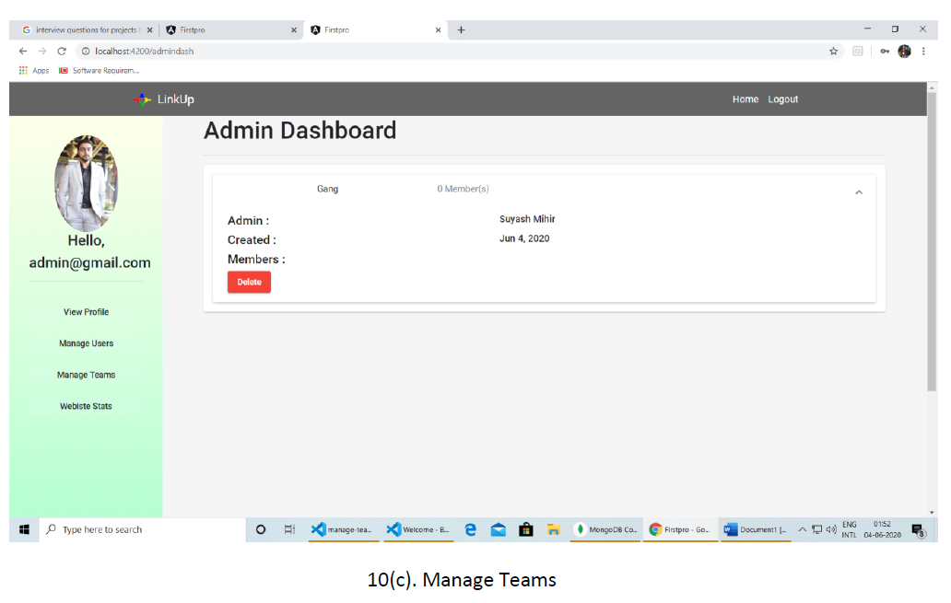
SCREENSHOTS

Slide 39
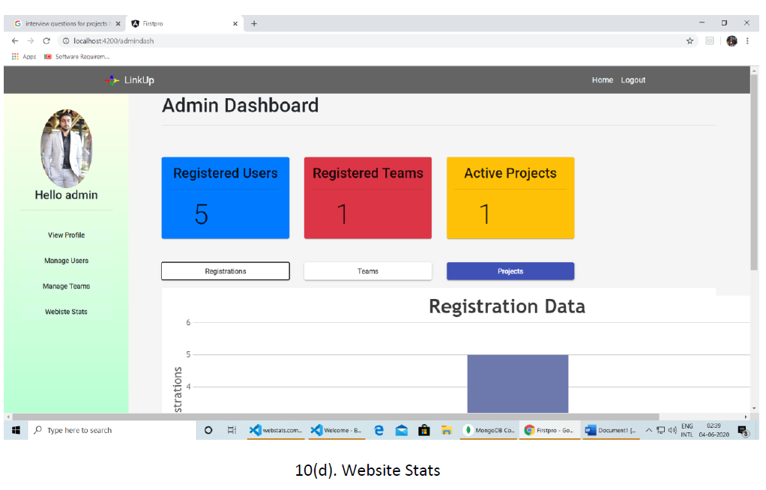
SCREENSHOTS

Slide 40
THANKs
FOR YOUR ATTENTION
PRESENTED BY-
PARAS JAIN-717035
SUYASH MIHIR-717019

